Slide 1

CAPSTONE PROJECT
DOMAIN: HOSPITALITY INDUSTRY
Team Members: 1. Balla Jagadish
2. Banothu Bharath
3. Liza Rani Choudhury
4. Nalam Saibhuvan
5.Narsapuram Vamshi Chary
Group Number : 2
Mentor Name : Mr. Animesh Tiwari
DATE : 26-02-2022

Slide 2

About the project :
Predicting Hotel Booking Cancellation
Is a machine learning classification
project that will try to predict
whether a booking will be cancelled or a booking
will not be cancelled using machine
learning based on historical data.
The data is originally from the article Hotel Booking Demand Datasets, written by Nuno Aantonio, Ana Almeida,and Luis Nunes for Data in Brief, Volume 22, February 2019.

Slide 3

Domain Introduction
1. Domain Introduction
2. Role of Data Science
3. Work Flow
4. Business Understaning /
Business Problem
5. Data Description
6. EDA
7. Data Preprocessing
8. Model Buidling
Role of Data Science
CONTENTS
Business Problem /
Problem Statement
CONTENTS
Data Description
Work Flow
Model Introduction

Slide 4

01
Domain Introduction

Slide 5
DOMAIN : HOSPITALITY INDUSTRY
Service industry that includes lodging, food and drink service, event planning, theme parks, travel and tourism.
Relationship between a guest and a host
The host receives the guest with some amount of goodwill, including the reception and entertainment of guests, visitors, or strangers.
Hospitality Industry includes
HOTELS
TOURISM
RESTUARANT AND BARS
EVENT PLANNING

Slide 6
02
Role
of
Data Science

Slide 7

Role of Data Science
Revenue Management
Customer Experience
Calculating and analyzing the performance metrics data, revenue managers can forecast room demand and customer behaviour to adapt room prices
Check-in with facial recognition
smart rooms with voice-control systems
Guest service with a robot’s help
Operational Analytics
Management
Real-time observation of internal processes done through operational analytics allows hoteliers to find missteps and look for ways to improve
Consumption Management
Unsing sensor data for predictive maintaince

Slide 8
03
Work Flow

Slide 9

WORK FLOW
Data Preprocessing
Feature Engineering
step 3
Step 5
Step 7
Model Evaluation
Business
Understanding
Step 1
Step 2
Step 4
Step 6
Data Understanding
Exploratory Data Analysis
Modelling

Slide 10

4
Business Problem
Business Understanding
Problem Statement

Slide 11

Booking cancellations have a substantial impact in demand management decisions in the hospitality industry.
It generates :
01
Revenue Loss.
02
limit the production of accurate forecasts
Business Problem
03
affect pricing and inventory allocation decisions

Slide 12
Global Cancellation Rate
Average Cancellation Rate 39.6%
Million
Numerical data in 2018 showed that most cancellations are made through OTAs, with Booking.com taking the top spot at 50.9% and Expedia at 26.1%.
Reservations with lead times longer than 60 days are 65% more likely to be canceled.
With a global average of almost 40% cancellation rate, this trend produces a very negative impact on hotel revenue and distribution management strategies

Slide 13




Reason for Booking Cancellations
Fraudulent Bookings
No-show Guests
Bookings that hotel usually indentifies as fraudulent and cancels on the spot
No-show refers to such types of guest who make the confirmed reservation but doesn’t arrived in the hotel at the time of arrival date without informing to the hotel
Last Minute Cancellation
Overboooking of Rooms
The demands of the customer does not meet like type of hotel
This situation takes place when there are more numbers of reservation request than the total numbers of saleable rooms in the hotel

Slide 14

Problem Statement
Predict whether a booking will be canceled or not to allow the hotel’s manager to make better decisions in order to improve overbooking strategies and cancellation policies.
Reason for this Study
accurately predict net demand and build better forecasts
improve cancellation policies
define better overbooking tactics
use more assertive pricing and inventory allocation strategies.

Slide 15
05
Data Description

Slide 16

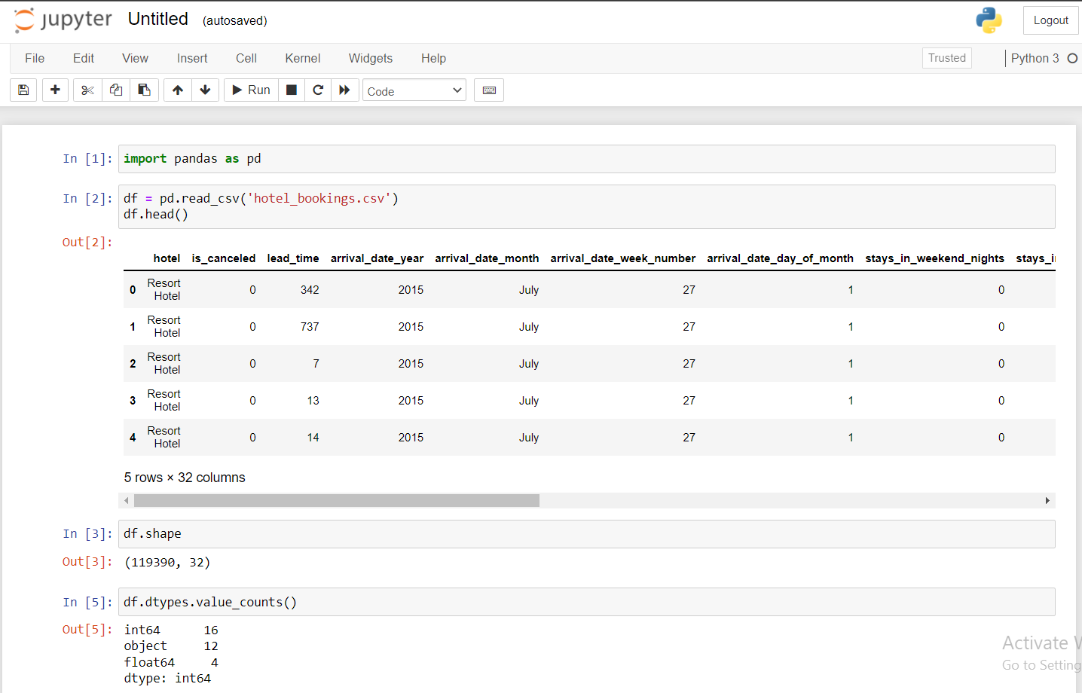
Dataset and Data Description
The data is originally from the article Hotel Booking Demand Datasets, written by Nuno Aantonio, Ana Almeida,and Luis Nunes for Data in Brief, Volume 22, February 2019.
Rows : 1,19,390
Columns : 32
DataTypes :
int - 16
object - 12
float - 4
Target variable : “is_canceled”

Slide 17
It includes 32 variables such as reservation and arrival,length of stay, canceled or not ,the number of adults,children,number of availabe parking spaces,total amount of special requests,agent,and/or company which made the reservation,etc.
The motivation of this project is to paint a clear picture on hotel booking demands.Predicting cancellation can be useful not only for the vacationer but for the hotels as well

Slide 18
Business Question:
List of Question to help achieving the goal - How Market Segment Of Booking Affecting Cancellation - How’s a lead time of a booking affecting cancellation - How’s different deposit type affecting cancellation of a booking - How does cancellation rate of booking from portugal and booking that’s made outside portugal - What Are The Other Factors that affecting cancellation of booking - What machine learning algorithm that has the highest accuracy when it comes predicting hotel booking cancellations

Slide 19
06
Exploratory Data
Analysis

Slide 20
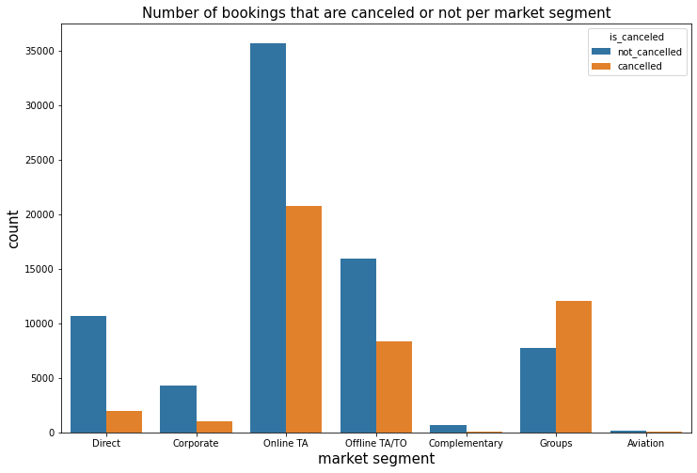
Cancellation Rate Per Market Segment
1. from our analysis we see that corporate , Direct has a cancellation rate around 18 - 22% of their booking
2. Travel Agent (Offline) and Groups has a cancellation rate around 34 - 36 %
3. Lastly Travel Agent(Online)has the highest cancellation rate around 61 %

Slide 21
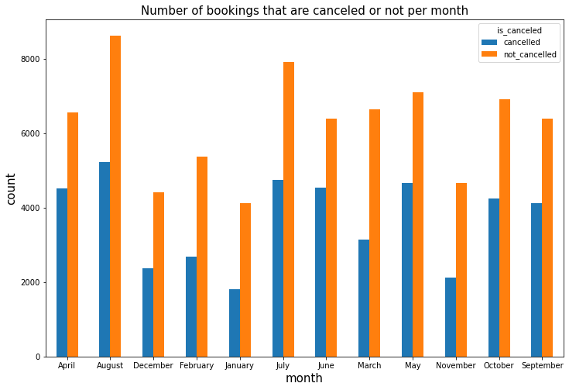
Monthly lead time and cancellation rate
● Booking that has less than or equal to 7 months lead time have a higher confirmed booking rate (>50%) to it
canceled rate
● Booking that has more than 7 months have a higher cancellation rate compared to it’s booking rate
● cancellation is positively correlated
with lead time
○ the higher the lead time the higher the cancellation rate
○ the shorter the lead time the less likely the booking will be cancelled

Slide 22
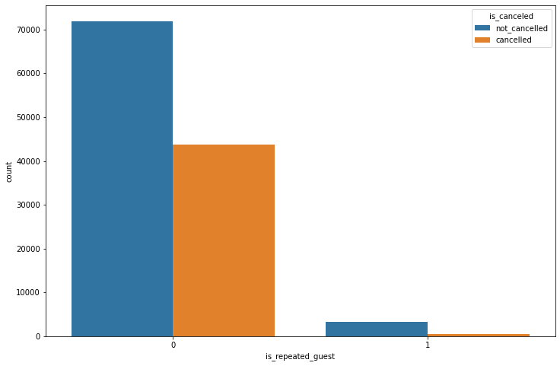
Repeated Guests and Cancellation Rate
● Repeated guests cancellation
rate is around 14 %
● Non Repeated guests are more than 2 x more likely to canceled their booking compared to repeated guest (34%)
in conclusion :
repeated guests are more likely to
confirmed the booking compared

Slide 23
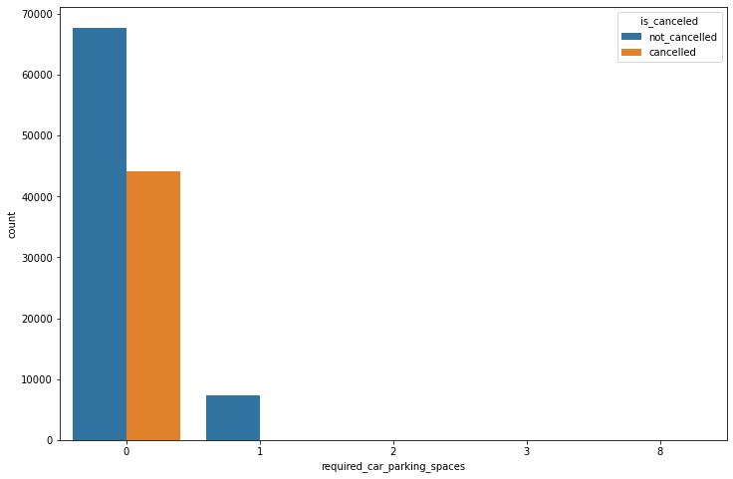
Parking Space and Cancellation:
From the dataset There are
7407 (6.2 %) out of total booking that required
a parking space .
● Out of 7407 bookings that required a parking space there’s not a single
booking that’s canceled ( 0
Cancellation for booking that required a parking space)
This conclude booking that required a
parking space will most likely be confirmed

Slide 24
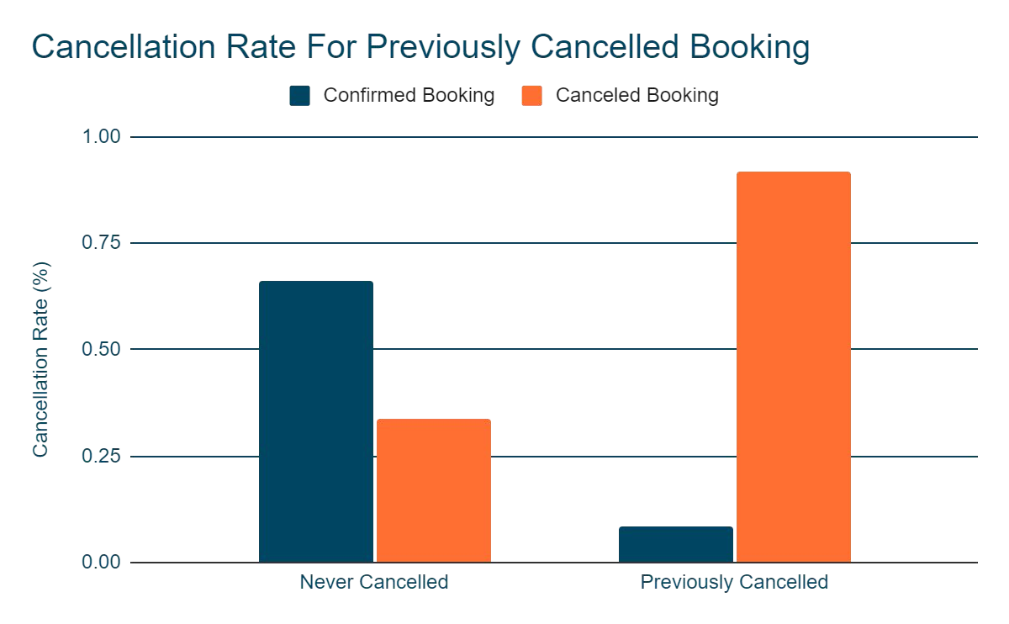
Previous Cancelled Booking and Cancellation Rate
● Booking That’s previously Canceled has 92% cancellation
rate
● Booking that’s never been canceled before has cancellation rate of 34%
this shows that booking
that has been canceled
before will more likely to be
cancelled again

Slide 25
EDA Recommendation
Stricter Cancellation Policy For Previously Canceled Booking:
Only Non Refundable
Deposit For Online Booking:
Maximum Lead Time for Booking:
We see a pattern of booking that has more than 210 days lead time are more likely to be canceled
setting up a maximum lead time means users wouldn’t be able to make booking that’s too far in
advance
Booking that’s previously canceled has cancellation rate of 92%.
looking at this pattern we see that booking that’s previously canceled are most likely to be canceled again.
to protect hotel from losing revenue due to this kind of cancellation, hotels need to set booking payment in
advance / non refundable deposit,or booking that has been canceled before
From the analysis we see that
group booking has the highest
cancellation rate.
With this policy hotel wouldn’t suffer any loss of revenue or loss of potential revenue due to cancelled online booking

Slide 26
06
Data Preprocessing

Slide 27
Data Preprocessing
1. Imputing missing value with median / mode using median instead of mean here because there are many outliers in the dataset.
2. Dropping columns that has more than 30% missing values.
3. Dropping rows with abnormal values
0 Total guests / adults in the booking
negative daily rate
4. Dropping row with outliers that’s super different compared to the other row in the columns.
Row with daily rate that’s above 5000 euro

Slide 28
Statistical Test Between Independent and Target Variables
Chi-square Independence Test between Categorical Variable and Target Variable
Null Hypothesis : The variables are independent
Alt Hypothesis : The variables are dependent
If p-value is less than 0.05, then we reject Null Hypothesis and conclude that the independent variable and target variable are dependent.
From the table we see that all the categorical values have p-value less than 0.05 with the target variable.
Category feature | Target variable | P-value | Description
Hotel | is_canceled | 0.0 | Reject Null Hypothesis
arrival_date_month |  | 3.67182e-199 | Reject Null Hypothesis
meal |  | 1.32123e-64 | Reject Null Hypothesis
country |  | 0.0 | Reject Null Hypothesis
market_segment |  | 0.0 | Reject Null Hypothesis
distribution_channel |  | 0.0 | Reject Null Hypothesis
reserved_room_type |  | 1.121956e-133 | Reject Null Hypothesis
assigned_room_type |  | 0.0 | Reject Null Hypothesis
deposit_type |  | 0.0 | Reject Null Hypothesis
customer_type |  | 0.0 | Reject Null Hypothesis
reservation_status |  | 0.0 | Reject Null Hypothesis

Slide 29
Statistical Test Between Independent and Target Variables
2-sample t-Test between Numerical Variable and Target Variable
Null Hypothesis : The variables are independent
Alt Hypothesis : The variables are dependent
If p-value is less than 0.05, then we reject Null Hypothesis and conclude that the independent variable and target variable are dependent.
From the table we see that all the numerical values have p-value less than 0.05 with the target variable.
Numerical feature | Target variable | P-value | Description
Lead_time | is_canceled | 0.0 | Reject Null Hypothesis
Arrival_date_year |  | 8.57248e-09 | Reject Null Hypothesis
Arrival_date_week_number |  | 0.004871 | Reject Null Hypothesis
Stays_in_weekend_nights |  | 0.0341 | Reject Null Hypothesis
Stays_in_week_nights |  | 1.14732e-1 | Reject Null Hypothesis
Adults |  | 1.0785e-95 | Reject Null Hypothesis
Arrival_date_day_of_month |  | 0.03416 | Reject Null Hypothesis
Babies |  | 0.0 | Reject Null Hypothesis
Is_repeated_guest |  | 2.31270e-189 | Reject Null Hypothesis
Previous_cancellations |  | 8.93266e-319 | Reject Null Hypothesis
Previous_bookings_not_canceled |  | 1.4894e-97 | Reject Null Hypothesis
Booking_changes |  | 0.0 | Reject Null Hypothesis
Days_in_waiting_list |  | 2.5036e-7 | Reject Null Hypothesis
Adr |  | 9.6829e-61 | Reject Null Hypothesis
Required_car_parking_spaces |  | 0.0 | Reject Null Hypothesis

Slide 30
06
Model Introduction

Slide 31
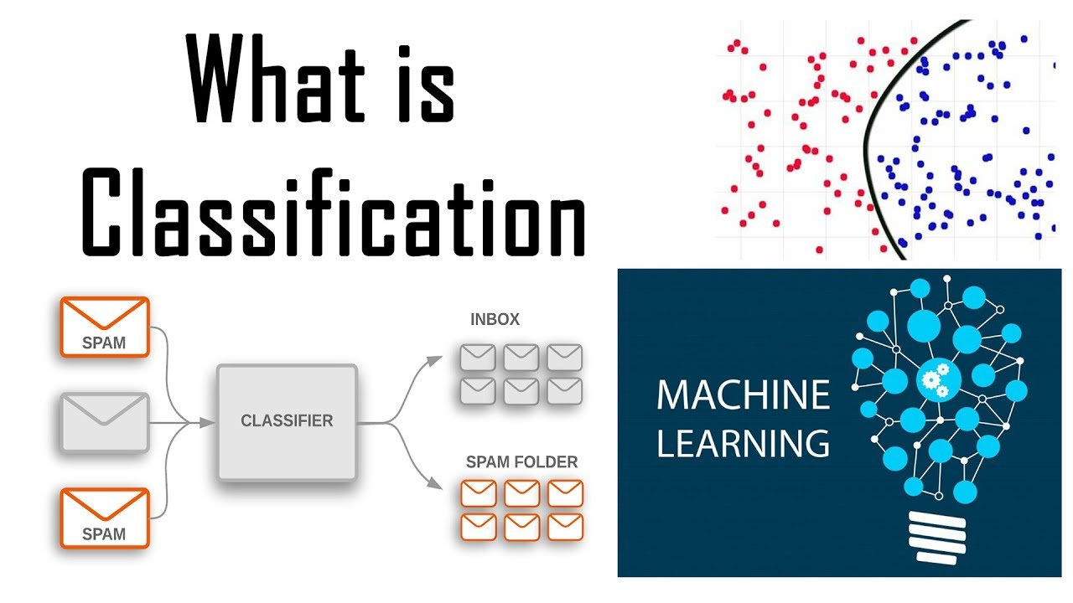
Introduction to Classification Algorithm
Classification Model
The Classification algorithm is a Supervised Learning technique that is used to identify the category of new observations on the basis of train data.
In Classification, a program learns from the given dataset or observations and then classifies new observation into a number of classes or groups..
The best example of an ML classification algorithm is “Email Spam Detector.”
The target variable in the dataset has unique values of ‘0’ and ‘1’ i.e it represents ‘not_canceled’ and ‘canceled’ respectively. This means the target variable has no measure of calculations and it represents two different classes of equal importance. Hence we use Classification Model to predict the whether the booking is canceled or not.

Slide 32
Machine Learning Algorithms used:
1.Logistic Regression
2. Decision Tree Classifier
3.Random Forest Classifier
4.KNeighbors Classifier
5.Naive Bayes Classifier
6.AdaBoost Classifier
7.Gradient Boosting Classifier
8.XGBoost Classifier
➢Now we build the above models on the training data and check the accuracy on train and test data.
➢If there is a significant difference between the train score and test score then the model is said to not fit with the training data.
➢We tune the hyperparameters using the GridSearchCV() if there is significant difference between the train and test accuracy scores.
➢We calculate all the performance metrics of respective model before and after tuning the hyperparameters and store it in a dataframe.
➢We also plot the confusion matrix and ROC curves of all the models before and after tuning the hyperparameters.
➢After calculating the performance metrics, train and test score, plotting confusion matrix and ROC curves , we will see which model is best using the accuracy score. We use accuracy score as evaluation metric because our data is nearly balanced with the target variable.

Slide 33
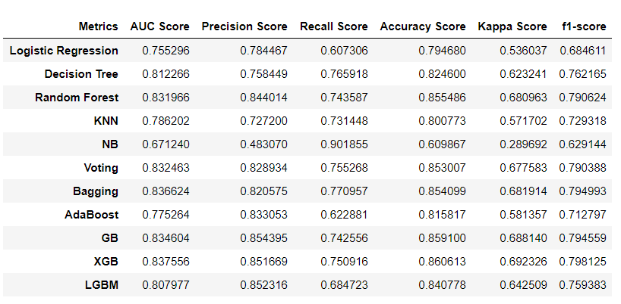
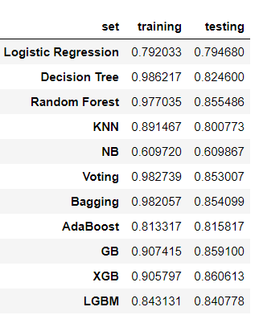
Base Model Evaluation Matrix
Performace Metrics before Tuning the Hyperparameters
Accuracy on Test and Train Data
We can see that accuracy score for XGB is highest of all the models.
Almost every model has the accuracy score near to 80 or more than 80 except for the NB model
Among all the models,LGBM classifier has the best training score and test score with very less siginificant difference between them

Slide 34
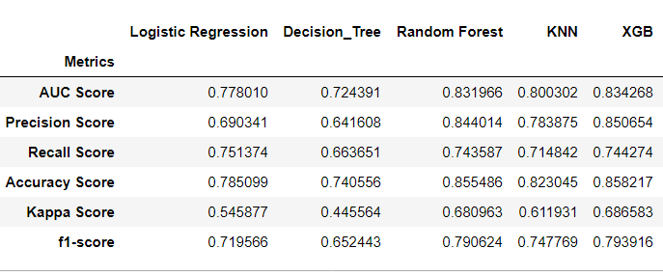
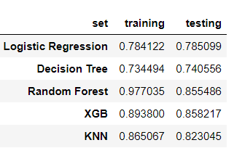
Tuned Model Evaluation Matrix
Performace Metrics after Tuning the Hyperparameters
Accuracy on train and test set
After Tuning the parameters, we can see that accuracy score of XGB is best among all the models.

Slide 35
Summary
Using Accuracy as the Primary Evaluation Metrics:
The first reason why accuracy is used as the evaluation metric here because we have somehow a balance data 63% confirmed booking and 37% canceled booking.
In this case our dataset is balance and hence using accuracy is acceptable in this case.
In this case every class is equally important.
Using Tuned XGB mode has the best accuracy among all the algorithm that was used:
From all the evaluation matrix to predict hotel cancellation classification case, we see that Tuned XGB model has the best accuracy when it comes to predicitng hotel cancellation based on certain features (85.82%)
Reservation Status have 1.00 association value with the target, because of the reservation status will tell whether the booking has been canceled, no show or checkout.
Using this column to build a model is prohibited because you wont be able to predict future booking, since the future booking still doesn’t have it status yet.

Slide 36
How this model helps ?
This model will allow the hotel managers/revenue manager to take actions on bookings that’s identified as “potentially going to be canceled”, furthermore the development of these model should contribute to hotel revenue management.
These prediction models enable hotel managers to mitigate revenue loss derived from booking cancellations and to mitigate the risks associated with overbooking (reallocation costs, cash or service compensations, and, particularly important today, social reputation costs). Booking cancellations models also allow hotel managers to implement less rigid cancellation policies, without increasing uncertainty. This has the potential to translate into more sales, since less rigid cancellation policies generate more bookings.

Slide 37
Limitations
1. Can a similar result obtained from hotel outside of portugal?
2. Can Model have a better result if more hotels are intergrated into the machine learning modeling?
3. Is the result only specific of the type of hotels integrated into this modeling?
Situation Limitation:
All of this booking are recording during 2015-2017, however from then we have a lot of situations happened like covid-19, this model needs to be double checked for current situation whether a similar result obtained after the considering these situations.
The machine learning model in this project implemented data from City & Resort Hotels in Portugal, which raise some question that further research will help to explain.

Slide 38
Future Research
For further research weather information, hotel factors (star of the hotels, brand, and etc) could be included into the dataset in hope to improve the models and measure the importance of these features.
Additional research with different locations, additional hotel could contribute to a better understanding of booking cancellations.

Slide 39
Challenges
Domain Knowledge
Dataset
modifying the columns(previous cancellations)
data preprocessing(abnormal values)
model building

Slide 40
THANKS

